Slide 1
National Core Indicator (NCI)
Mail-Out Family Surveys

Slide 3
SCDD San Bernardino Regional Office
Kern
Inland
Tri-Counties

Slide 4
Families of the regional center will receive one of three NCI surveys based on whether the family member with I/DD is:
a child living in the family home
an adult living in the family home
an adult living outside of the family home

Slide 5
Surveys are mailed directly from the State Council on Developmental Disabilities (SCDD) to the families of regional center clients.
Families are encouraged to fill out the survey on paper and mail it in the pre-paid envelope OR use the code provided in the letter to complete the survey online.
SCDD needs the support of Advisory and Community Groups who work close with clients and families.
Please help make the effort of the NCI project a success by encouraging families of clients to complete and return the survey.

Slide 6
Resources provided at the end of the electronic survey
Resources
Links
Results from Previous Years --------------------------------------- Regional Center Performance by topic ------------------------- NCI contact information -------------------------------------------- For more regional center resources ----------------------------- Covid-19 ---------------------------------------------------------------- Health-------------------------------------------------------------------- Emergency Preparedness-------------------------------------------
www.dds.ca.gov/rc/nci/nci-interactive-dashboard/
www.dds.ca.gov/nci/nci-domain-dashboards/
www.dds.ca.gov/rc/nci/
www.dds.ca.gov/rc/
www.covid19.ca.gov
www.cdph.ca.gov/Programs/CID/DCDC/Pages/Immunization/ncov2019.aspx
Wellness Toolkit - CA Department of Developmental Services

Slide 7
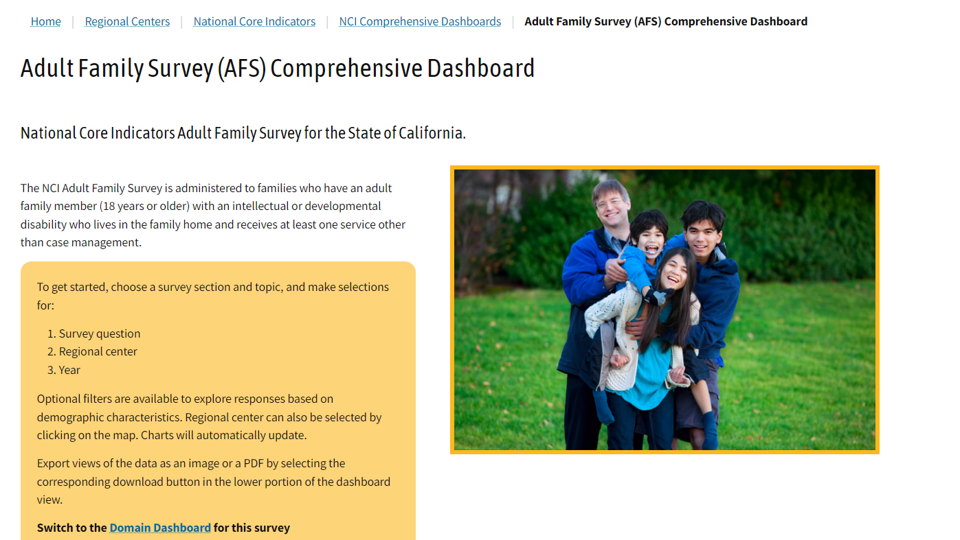

Slide 8
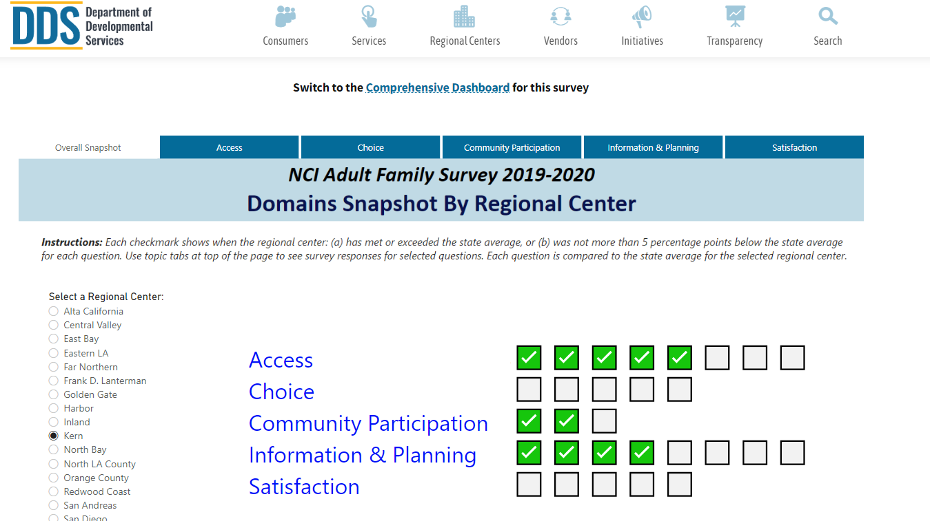

Slide 9
NCI Quality Assessment Project
In-Person Survey

Slide 10
National Core Indicator (NCI)
Quality Assessment Project
In 2010, The State Council on Developmental Disabilities, in cooperation with The Department of Developmental Services (DDS) and Human Services Research Institute (HSRI) joined 26 other states in conducting quality assessment interviews using the nationally recognized National Core Indicators (NCI) assessment tool.
The responses to these surveys help California identify essential changes necessary to improve the quality of the service delivery system at a statewide and local level

Slide 12
NCI QA Project Surveyor Recruitment
Surveyors are wanted throughout the Inyo, Mono, Tri-Counties and Inland Regions
The next cycle is anticipated to begin September 2024. Recruitment for this cycle will begin April/May 2024. If you are interested in being notified in Spring of 2024 when recruitment begins, please Join the QA Project mailing list.
Log into Https://scdd.ca.gov/qap
Click on

Slide 13
Thank you, for your continued dedication and collaborative efforts.

